Slide 1


Visualization and analysis of epidemic in Shanghai, 2022
2022上海疫情数据分析与可视化
Group Member:
乔宇堂 王婧婷 张敏慎

Slide 2
Contents
Data Gathering and Cleaning
Web crawlers
Data Analysis and Interpretation
Curve fit by least Square Method SEIRD Model
Visualization
Infection rate of every district Infection rate and population density
Conclusion
The conclusion of our Project

Slide 3

Data —
We use the method of Web crawlers to gather the data we need to use from the websites below. Considering the reliability of it, we found the government websites.
Gathering
National Health Commission of the People's Republic of China
Shanghai Municipal Health Commission
Shanghai Bendibao
Progress in epidemic prevention and control

Slide 4




National Health Commission of the People's Republic of China
Shanghai Municipal Health Commission
Websites
Shanghai Bendibao
Progress in epidemic prevention and control
3.6-5.31

Slide 5
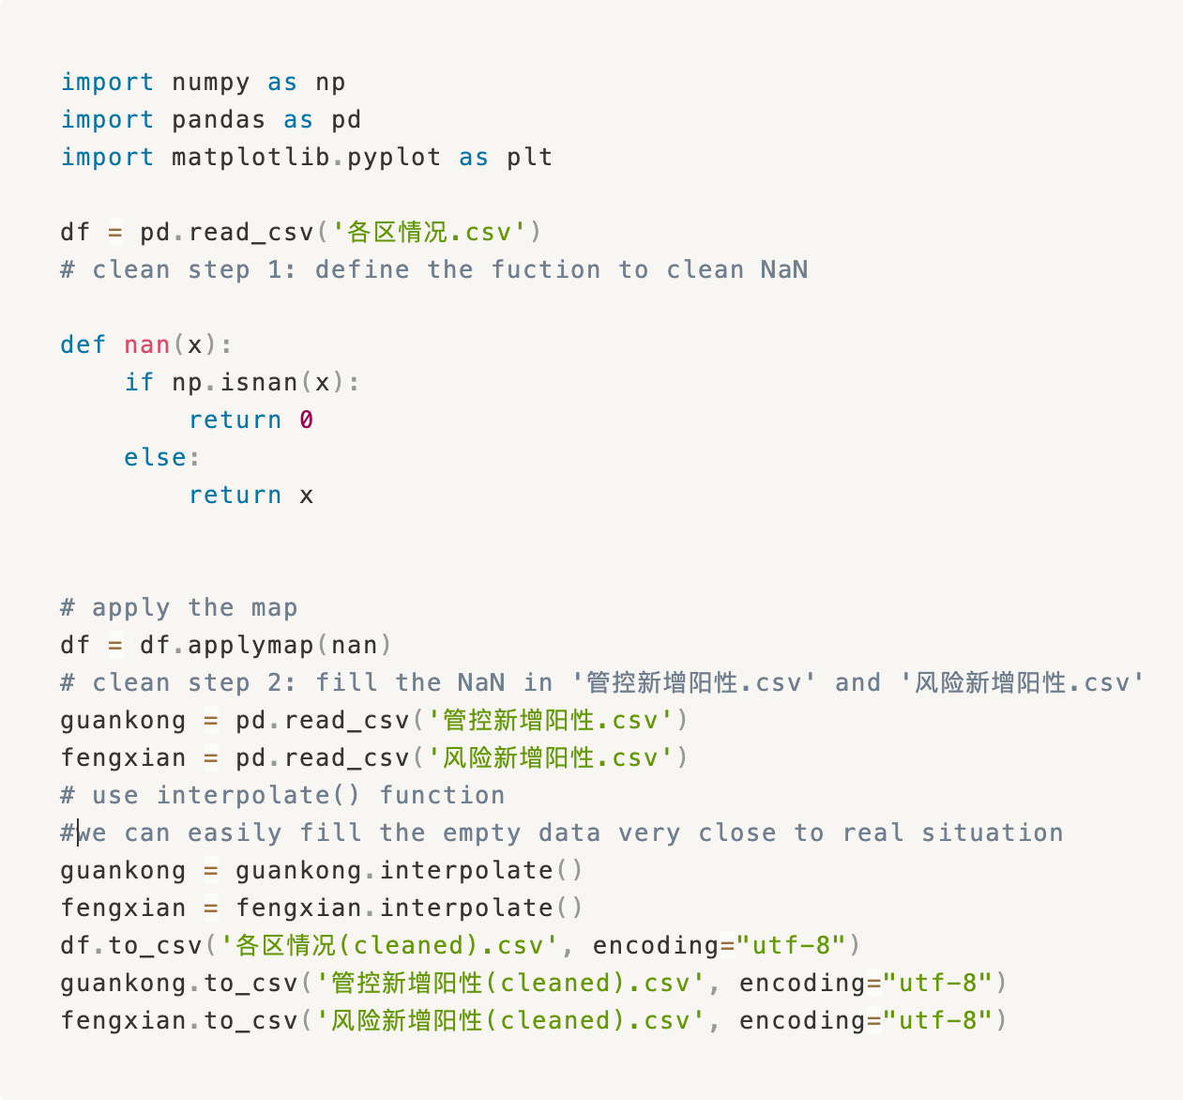
Data Cleaning
We clean the data by the following code

Slide 6
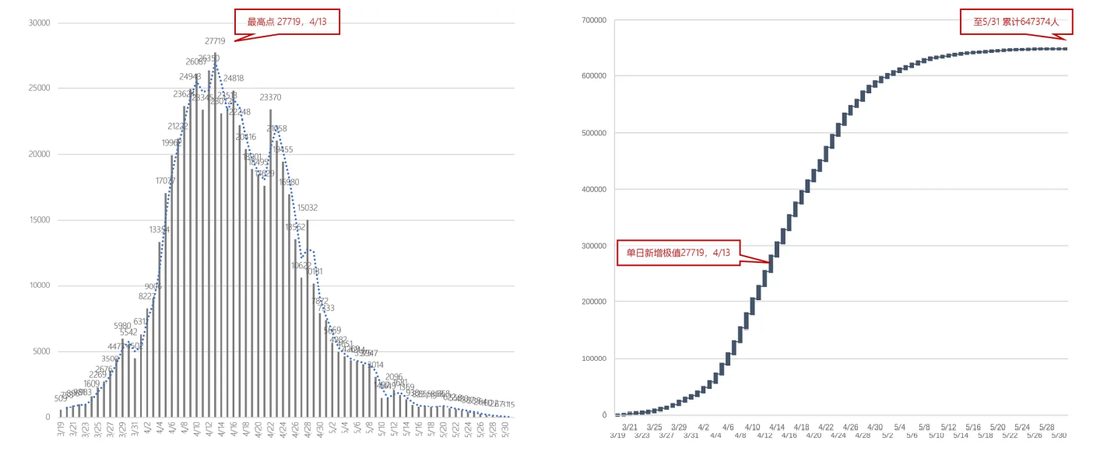
Data Analysis
We first get a brief impression about the epidemic:

Slide 7
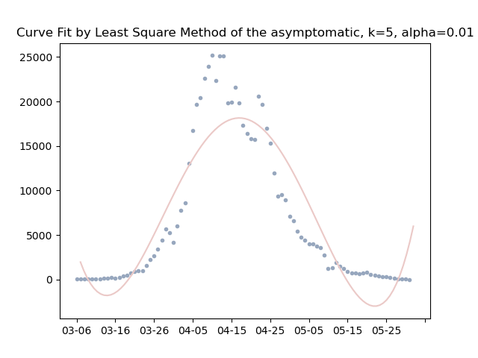
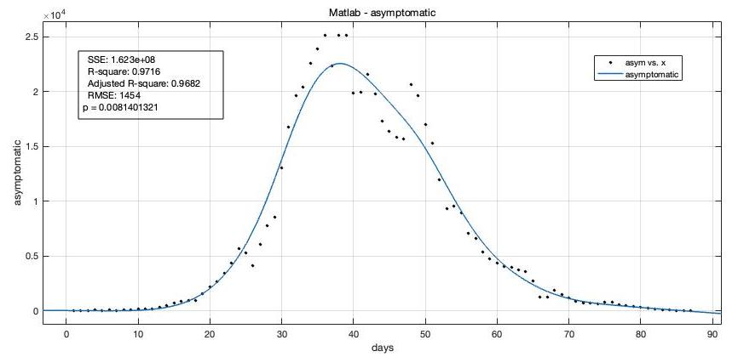
Curve Fit
Curve fit by least Square Method
Matlab Curve Fitting Smoothing Spline

Slide 8
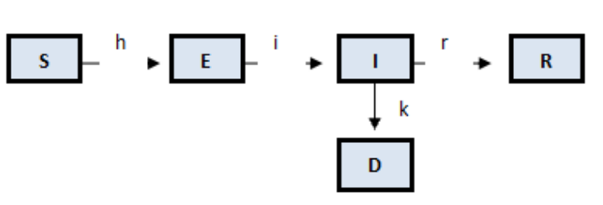

SEIRD Model
Daily trend
Variable Declaration and Basic assumptions
Let S be the number of susceptible people, E be the number of people already exposed to the virus but having no symptoms, I be the number of people infected and are showing symptoms, R be the number of people recovered, and D be the number of death.
$$S+E+I+R+D=Constant= P \\ C=a∙ b∙P \\ R=abP∙\frac{1}{r}=C∙\frac{1}{r}$$
The Assumption
Infection Chain

Slide 9
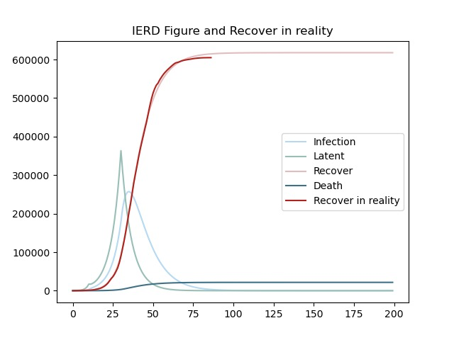
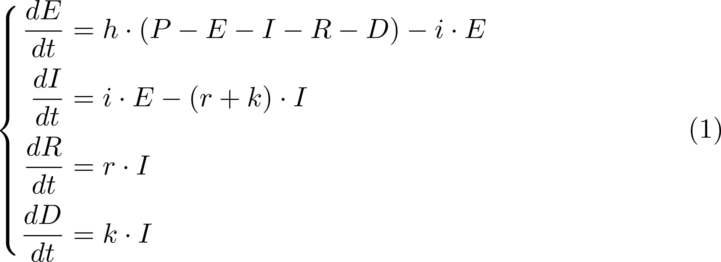
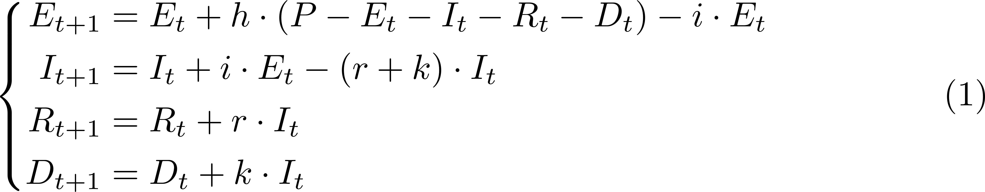
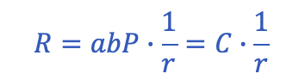
$$R=abP∙\frac{1}{r}=C∙\frac{1}{r}$$
SEIRD Model

Slide 10
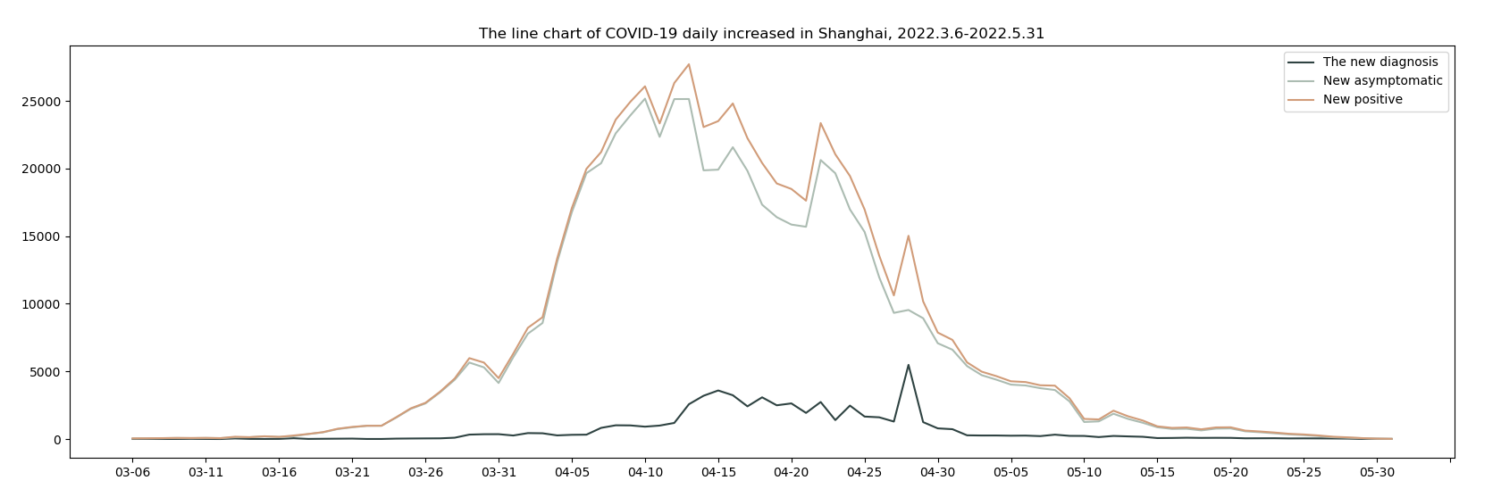
Critical Date
On March 28th, Pudong sealed itself(封城)
On April 11, Puxi sealed itself
Data -
With a perspective of every district
In the 74 days, Pudong New Area had the largest number of new positive people on the day for most times(26). The second was Yangpu District, a total of 19 times.
From 3/27 to 5/2, Pudong New Area ranked first in the number of new people in Shanghai for 37 consecutive days. It can be said that throughout April, the epidemic in Shanghai was pushed up by Pudong, the worst-hit area in the city.
At the beginning of the epidemic, Pudong and Minhang took the lead alternately. After that, Pudong firmly occupied the first place. From May 1st, Huangpu began to be serious. Since the middle of May, Yangpu has become the leader.
April 13 was the highest number of new cases in the single district of this epidemic, with 15,027 cases in Pudong New Area.
Interpretation
With a perspective of the whole city
Shanghai has 647,374 positive cases overall
An average of 8,748 people are infected every day
The peak of number of increasing infection is 27,719
Pudong New Area increased 15,027 infected people on April 13, which is the largest number over all districts and all time during Shanghai’s Epedemic
In terms of the number of infected people, Pudong New Area is the worst one, with 227,104 positive cases, but we do need to keep in mind that Pudong New Area has the largest population within all districts
In terms of proportion of infection, Huangpu District is the worst, with an infection rate of 9.26%
The city-wide average was 2.60%, which means we can find one infected individual in a group of roughly 40 people

Slide 11

Visualiz-ation
DESIGN BY WUYONG
3
Rich Content Presentation
Flexible creative ideas

Slide 12
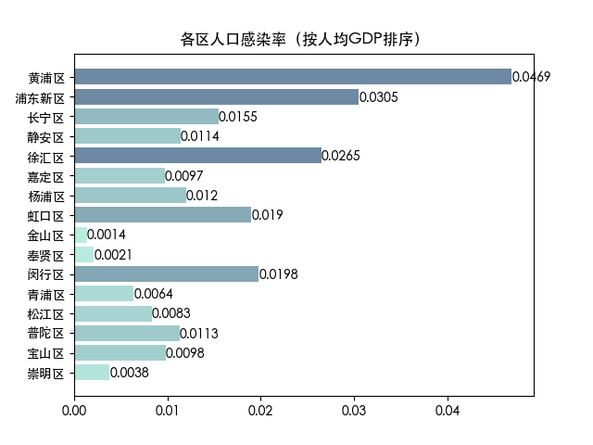
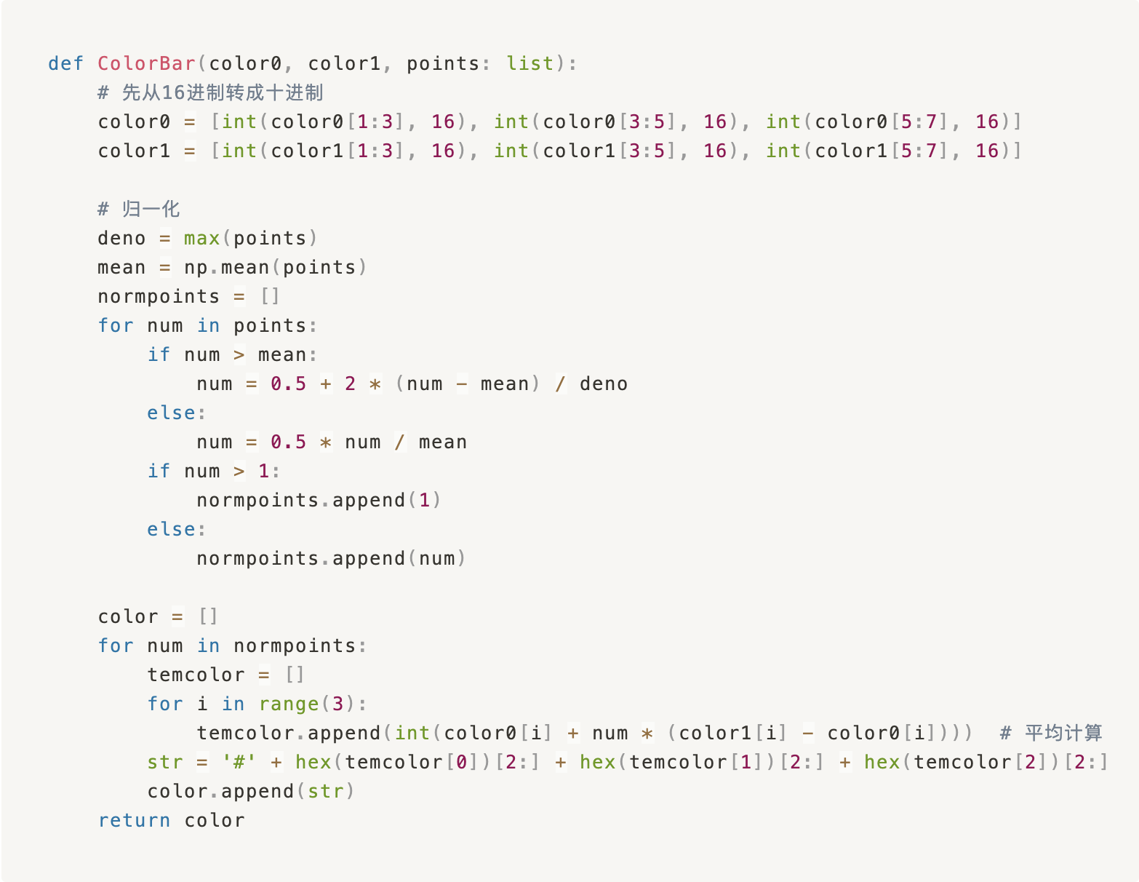
Visualization
With the help of the library ‘Matplotlib’, we tried many different chart forms to best show the relationship of our data, and provide support for our final conclusion or assumptions. Including histogram, column diagram, map, line chart and scatter.
Besides, we also consider the help of color. To show the result more visually, we designed a function to customize our sequential color. To ensure it to work well, we consider the number distribution and design a function to do more than normal normalization.

Slide 13
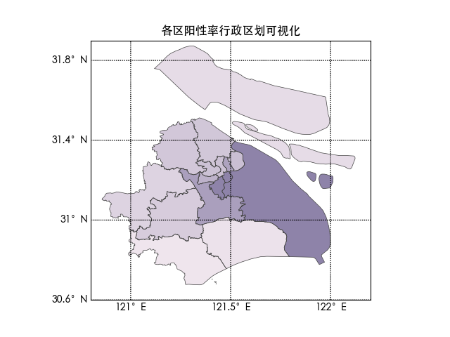
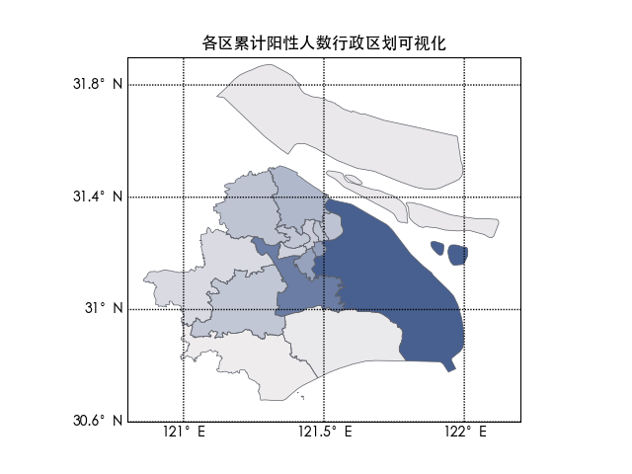
Visualization about infection rate of every district
Firstly, we can have a basic impression of the whole situation in every district with the map.
We use basemap to realize it.

Slide 14
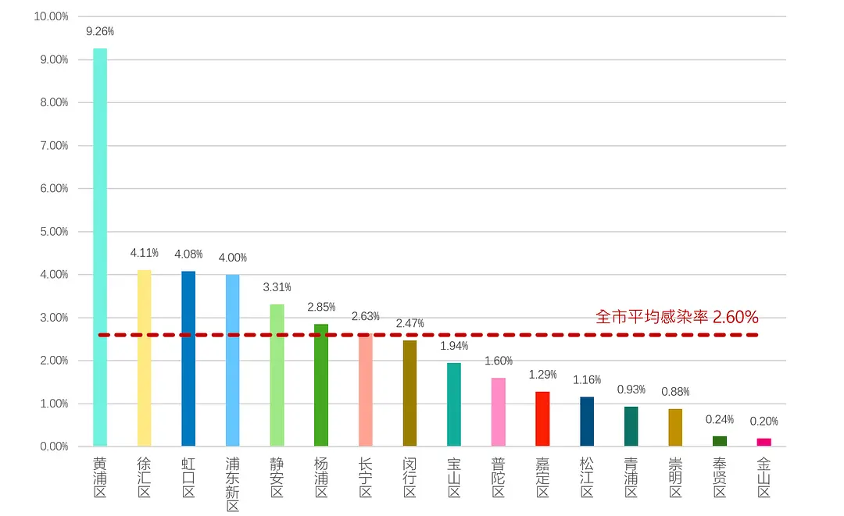
Infection rate of every district
Huangpu District had the highest infection rate among all districts of the city, at roughly 9.26%, or we can say, nearly one in 10. This means that in Huangpu district, almost every building, every class, every extended family, someone will be infected.
Although the total number of positive infections in Pudong New Area is the highest in the city, the infection rate is not very prominent due to the large number of adults in the area.
The average infection rate in Shanghai was 2.60 percent. Six districts were above average and 10 were below average, indicating that the epidemic was not evenly distributed.

Slide 15
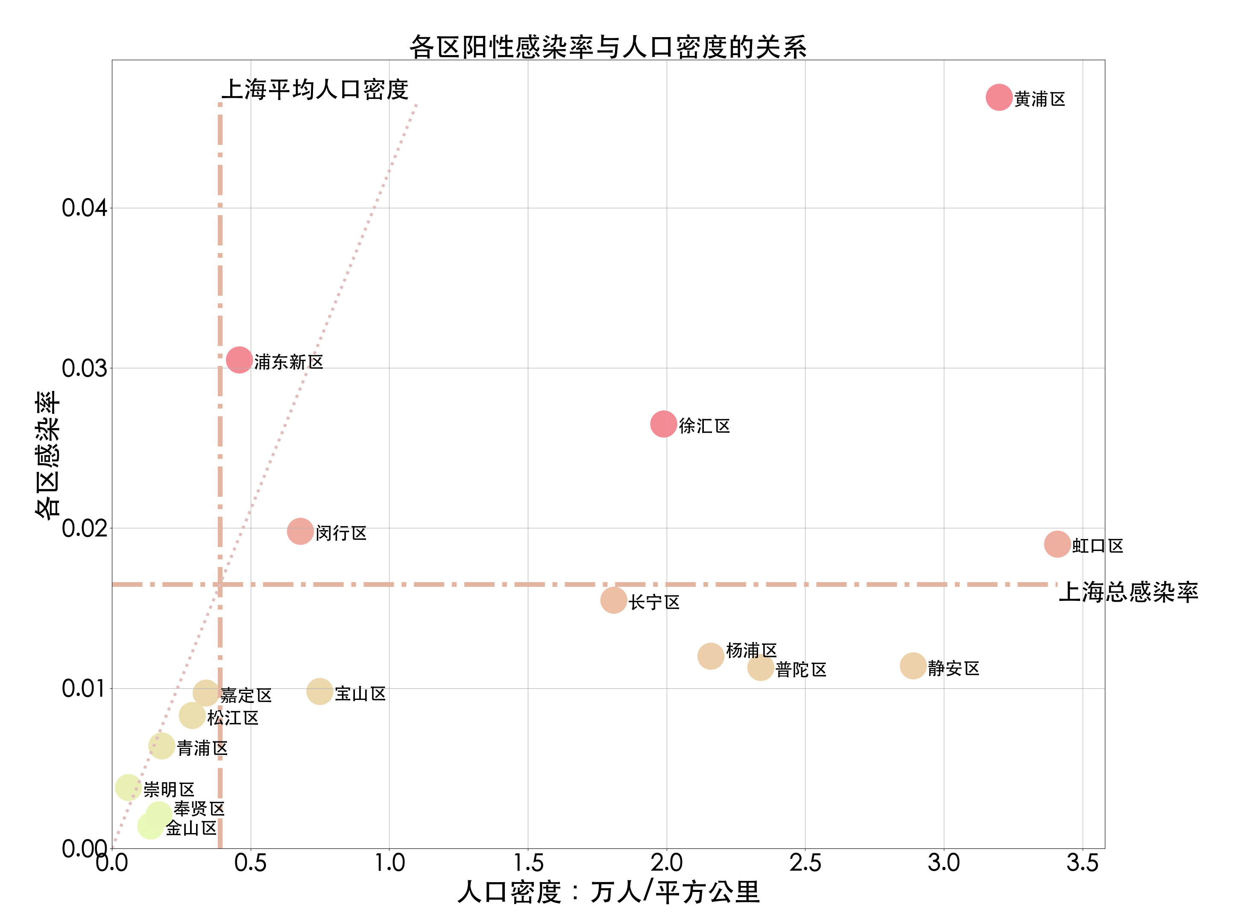
Infection rate and population density
Key Information:
The first quadrant represents a large population with high infection rates
The second quadrant represents low population density but high infection rates
The third quadrant represents low population density and low infection rates
The fourth quadrant represents high population density and low infection rates
The Line we draw on this graph indicates the average situation of the whole city, while the district above this line indicates that the district has higher infection/population ratio and vice versa.
26 +
Summary about this visualization:
Although the infection rate of Huangpu district is high, its population density is also high, and the overall ratio is lower than the average situation of Shanghai
Pudong New Area is actually the hardest-hit area in Shanghai
Jing'an district and Putuo District performed quite well during this epidemic, while the infection rate remained low in the case of high population density

Slide 16
Conclusion
DESIGN BY WUYONG
4
Rich Content Presentation
Flexible creative ideas

Slide 17

/
Daily Turn Positive and Recover Rate
By the SEIRD model, we can know that the Daily Turn Positive Rate is about 1/7, the Daily Recover Rate is about 1/10, and wearing masks can greatly reduce the Infection factor by up to 10 and 100 times.
Most Positive Infections
average infection rate
Although the total number of positive infections in Pudong New Area is the highest in the city, the infection rate is not very prominent due to the large number of adults in the area. But by visualization, we know Pudong New Area performed worst during this epidemic.
The average infection rate in Shanghai was 2.60 percent. Six districts were above average and 10 were below average, indicating that the epidemic was not evenly distributed.
crucial conclusion

Slide 18
Thanks
Creator Information
Listening
DESIGN BY WUYONG
PPT By ©WUYONG

